Slide 1
Automated Scavenging System
Presented by
Tarunvel V S(161ME306)

Slide 2
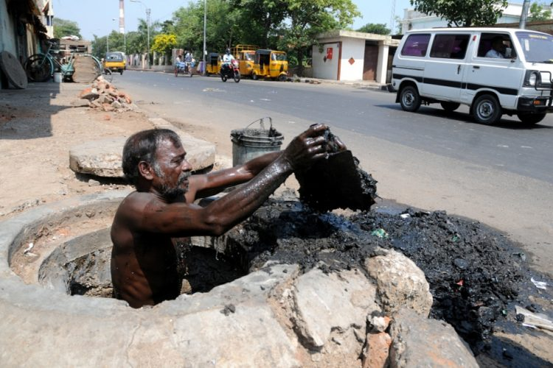
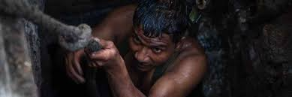
PROBLEM STATEMENT
The major problem in recent days is cleaning of large tunnels and pipes used by sewage systems in cities.
These large tunnels and pipes are cleaned by humans, who suffer from various diseases due to it.
The lifespan of these sewage cleaners are very short lived as 45% of these workers die within the age of 50.
Apart from death, they also fall victims of deadly diseases like asthma, Cholera, etc.

Slide 3
SOLUTIONS TO THE PROBLEM
The solution is designing a portable manhole cleaning machine. The machine will serve as a good alternative for the manhole cleaning workers.
The device contains various kinematic linkages and pneumatic cylinders which can be operated with minimal power requirement.
It will help to save the lives of many sewage workers.
MANHOLE CLEANING ROBOHOLE/MACHINE CLEANER

Slide 4
SURVEY ON THE PROBLEM AND SOLUTION
On surveying about the manhole cleaning, it was found that the damped wastes releases highly toxic gases and overall mass of the blockage to be cleared is comparatively larger.
Thus high power tools are required for the cleaning process. The materials used are required to have high corrosion resistance and large load handling capacities.

Slide 5
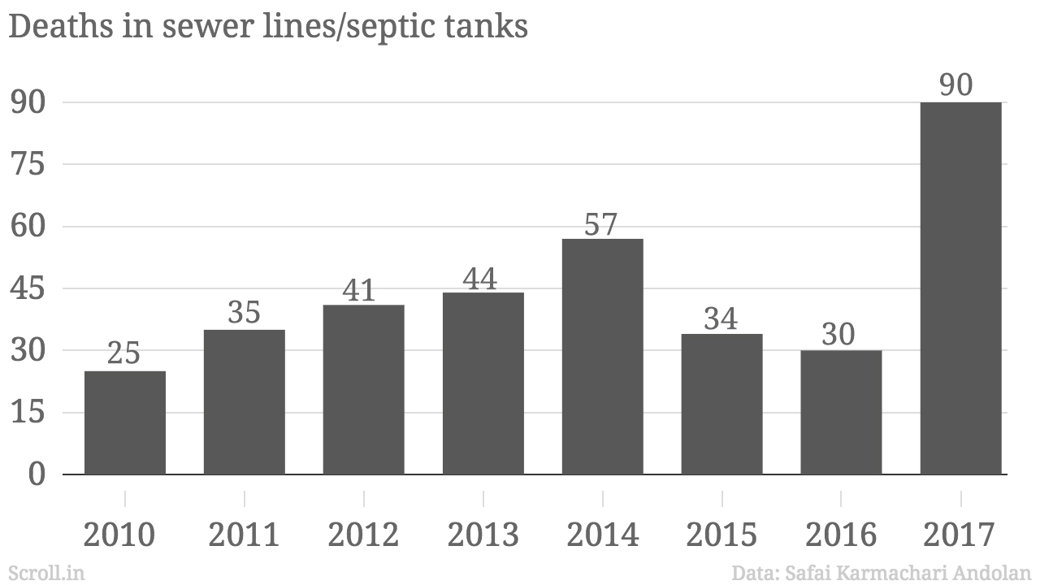
On the other side death ratio of the manhole cleaners are still rising to date. As Engineers we are responsible for providing perfect solutions to the problems faced by the manhole cleaners.
There are a variety of devices available for manhole cleaning but they are not cost efficient and user friendly.

Slide 6
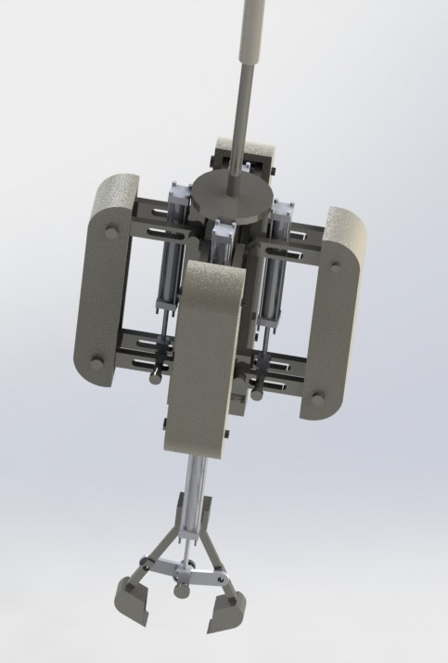
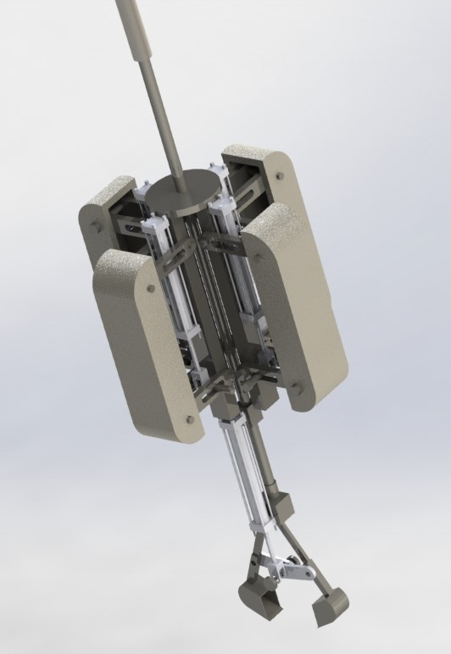
Initial product design

Slide 7
Design calculations
1.size of manhole
1.1 Rectangular type manhole
Minimum dimensions= 300mm x 300mm
Maximum dimensions= 1200mm x 1200mm
1.2 Circular type manhole
Minimum diameter= 450mm
Maximum diameter= 600mm
2. Total size of the PSB with respect to manhole
Diameter= 400mm
Length=800mm
3. pneumatic cylinder
Stroke length=75mm
4. path of travel of PSB into the manhole depth=1000mm
5.amount of solid waste collected by the bucket for single take=2kg
(calculated based on the volume of the bucket and holding capacity)

Slide 8
USABILITY & FEASIBILIY
The PSB is user friendly for the sewage workers as it has very simple working principle and mechanism. Large care is taken towards making the bot user-friendly for the workers So they can take the job of operaters instead of manual scavenging.
Since the Bot can adapt to a large range of manhole dimensions it can be used for manholes and pipes of various sizes and dimensions.

Slide 9
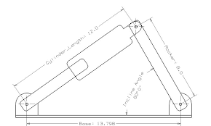
Working principle
The working principle of the PSB is the simple expansion and retraction of the pneumatic cylinder, where the pneumatic cylinders transfer power to the kinematic linages.
Based on the expansion and retraction amount of the pneumatic cylinder kinematic, linkages contracts and expands for their further functions.

Slide 10
Working flow chart
starting of the winch motor
lowering of the main supporting part(into the manhole)
expansion of the gripper arm(using pneumatic cylinder)
collection of sewage waste in the manhole
removal of the sewage from the manhole

Slide 11
Disadvantages of the existing methods
The major disadvantages of the conventional manual cleaning is increased death ratio of workers
The machine existing may not efficient for proper blockage clearance in the manhole. The cost of the existing machine is high and it is difficult to implant in society due various production causes.

Slide 12
Advantages
It will the better alternative for others devices present in the market
It would provide higher outcomes when compared to others.
The major advantage over other machines is cost efficient.
It will replace the conventional manhole cleaning process and help to save the invaluable lives of numerous manhole cleaners.

Slide 13
Disadvantages
The major drawback is the lack of proper vision inside the manhole for collection of the sewage waste.
The kind of problems can be rectified by further studies and improvements.

Slide 14
Further study & improvements
we are in need of providing the sensing unit which contains various sensors for proper sensing of the movements happening inside the manhole,
Another important improvement is providing the lighting system with camera, which visualizes the movements happening in the manhole in the display kept on the control panel.

